Slide 1
EYE KING SUNGLASSES
FOB: New Jersey

Slide 2
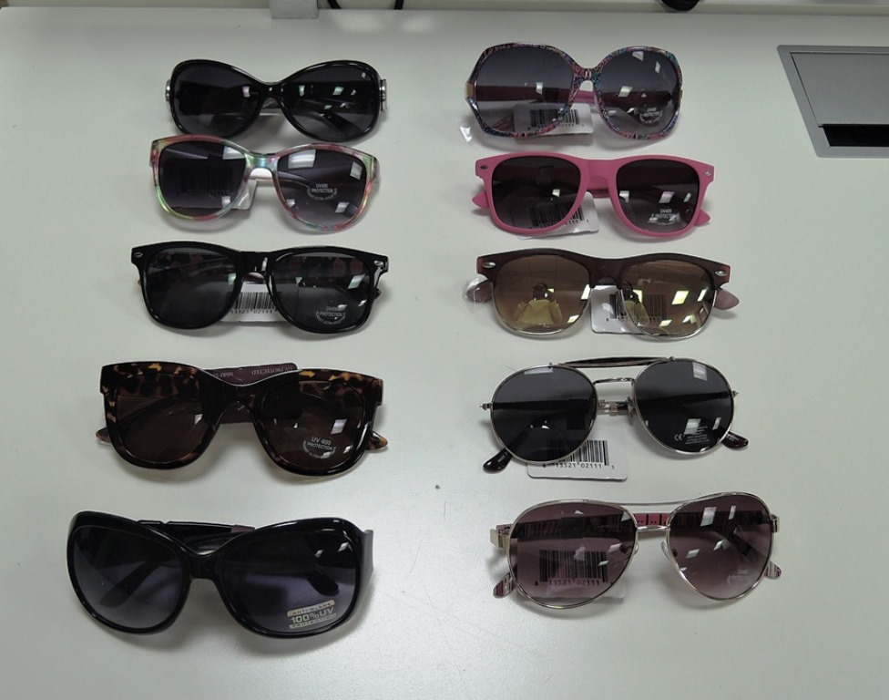
WOMEN’S SUNGLASSES
Case Pack: 144
Assorted Units per case
MSRP: $24.99
FOB: Hackensack, NJ
UPC code: 813521021115
Item #: 02111

Slide 3
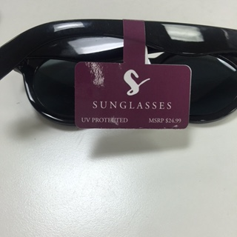
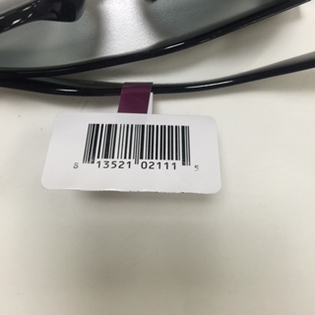

Slide 4
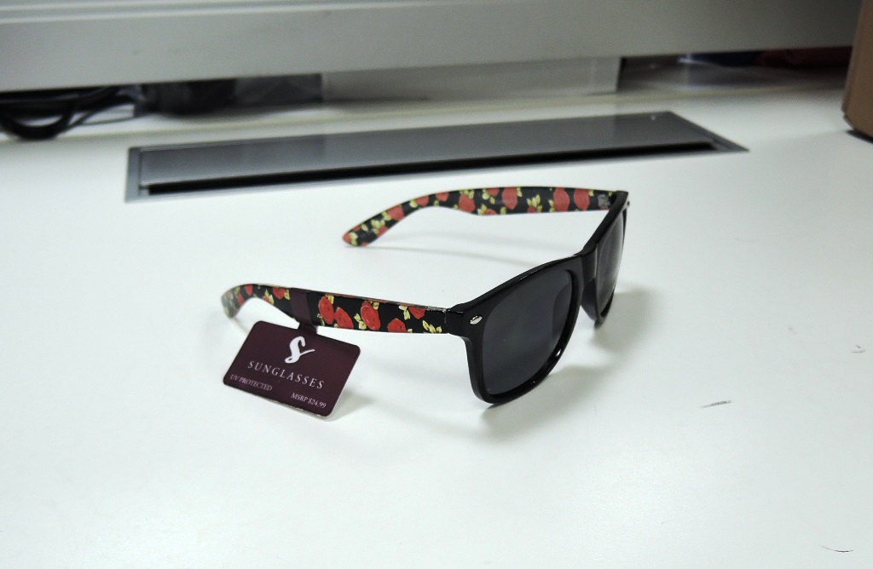
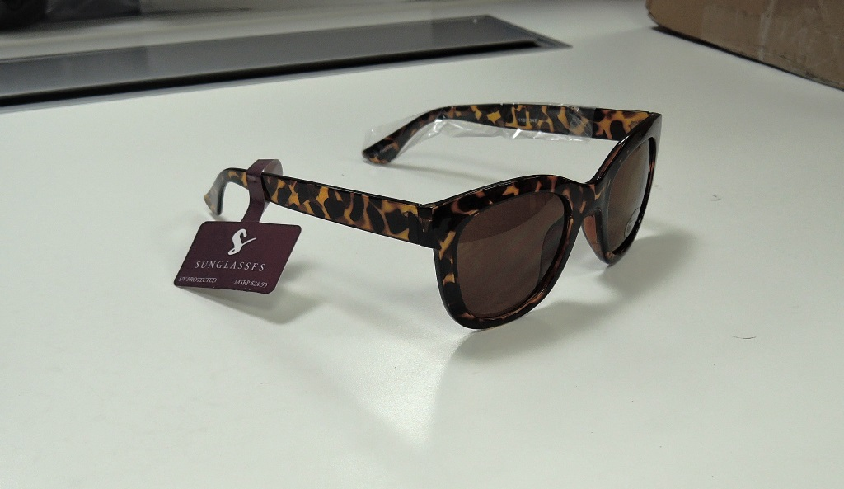

Slide 5
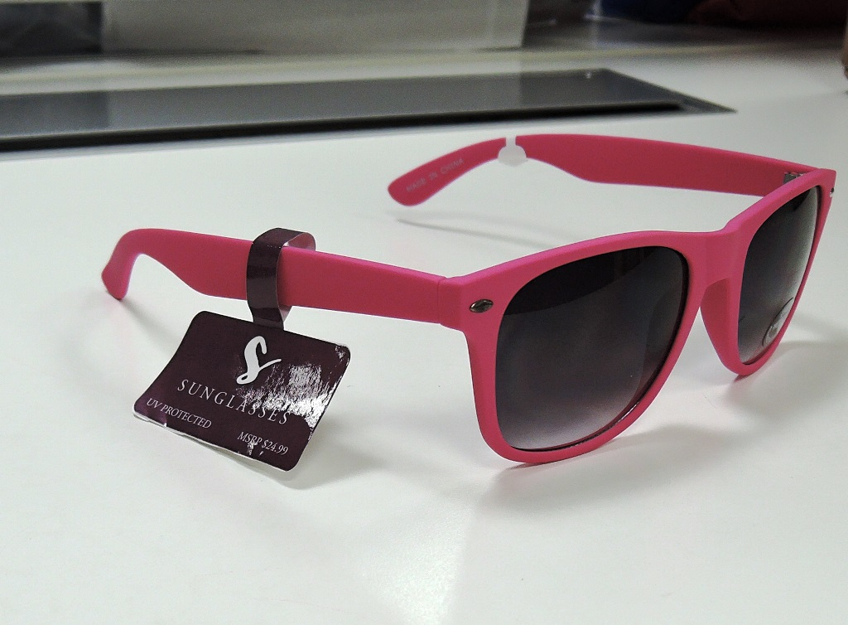
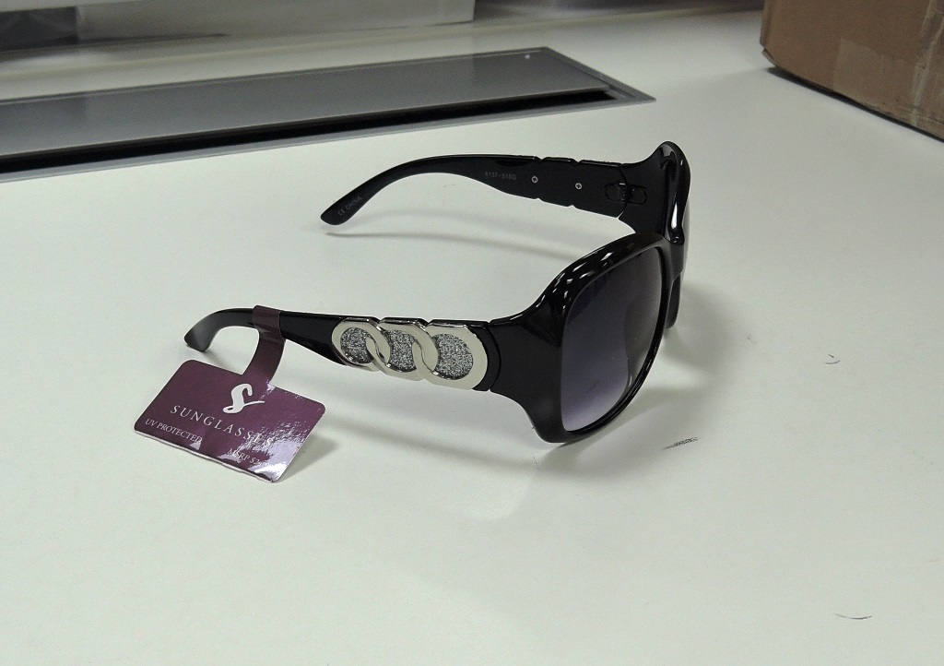

Slide 6
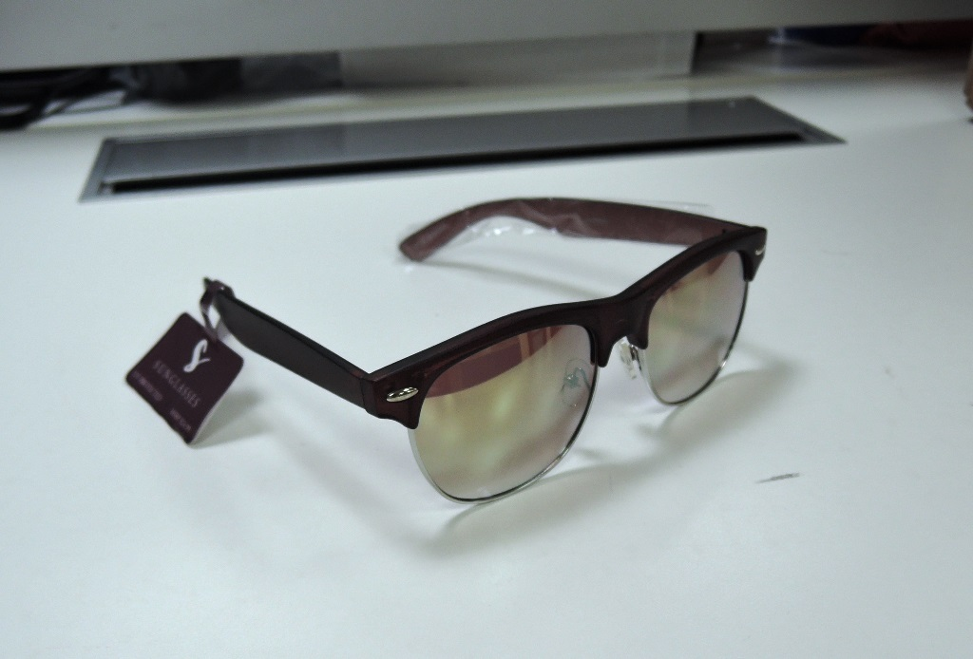
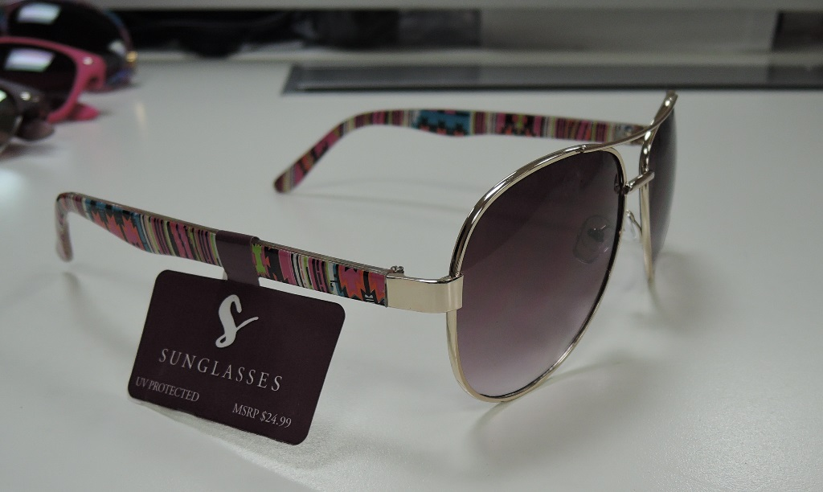

Slide 7
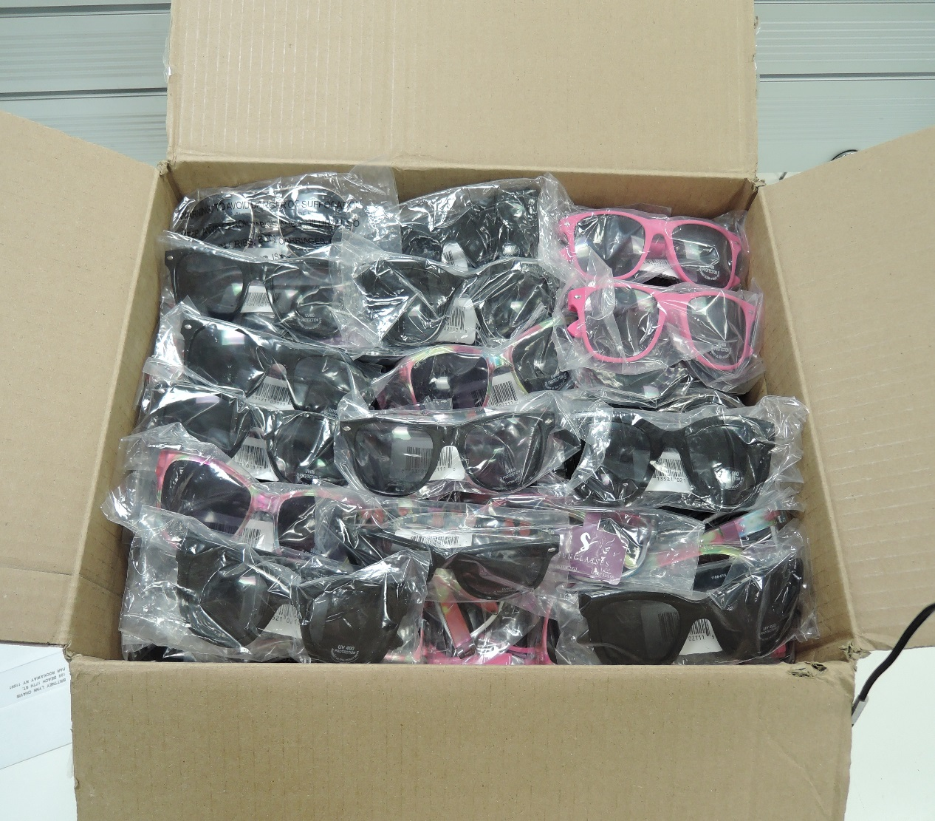
SAMPLE CASE

